Slide 1



Part 1
By: Omer Ben-Naim, Maya Saghiv

Slide 2

Agenda
Project Overview – Dataset & Goal
Dataset Preparation & Preprocessing
Filtering & Cleaning
Extracting Valuable Data
Plan of Attack
Filters
Methods
Techniques
Performance Measures
Challenges
Notes:
Project overview:
Project description
Project goal
Dataset overview:
Background
Datasets show – printscreen of 3 datasets – data, user, movies
Plan of attack:
Preperation & preprocessing
Descriptive statistics (users, movies & rates)
Methods – collaborative, content
Models - ….
Performance measures
*challenges

Slide 3
Overview – Dataset & Goal (1)
MovieLens Dataset:
100,000 ratings (1 to 5)
1682 movies
943 users (each rated at least 20 movies)
MovieLens website (movielens.umn.edu) – collected the data during 09/1997-04/1998
GroupLens Project – Research Group, Computer Science & Engineering, University of Minnesota
Notes:
OMER

Slide 4
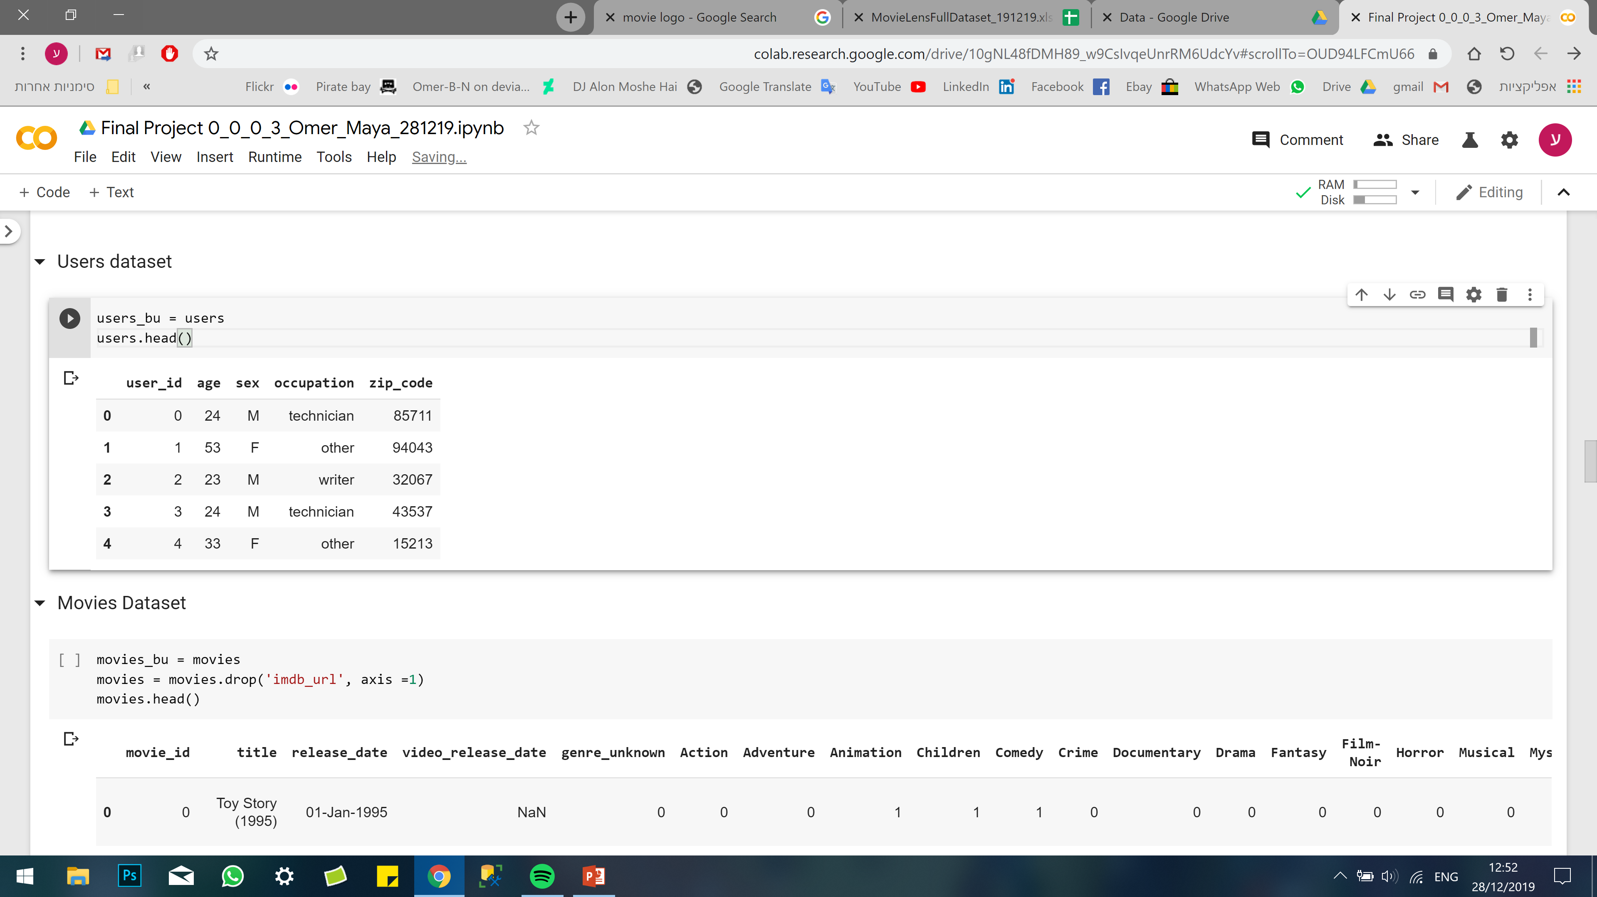
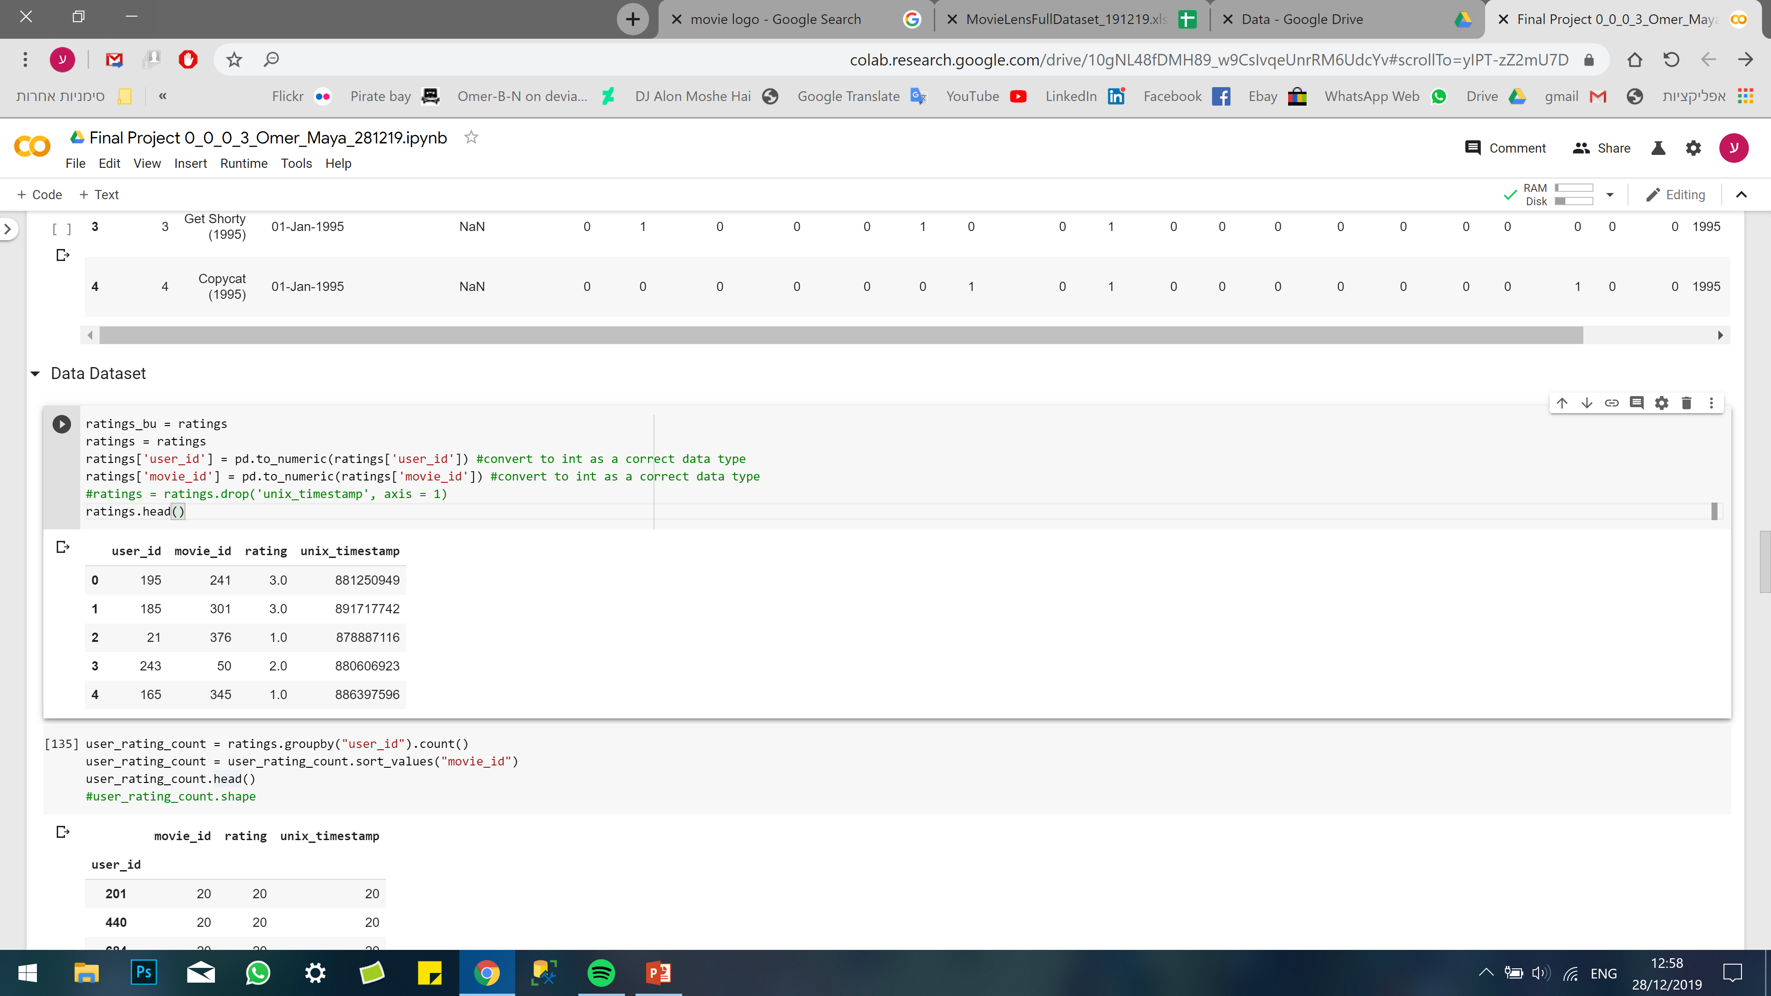
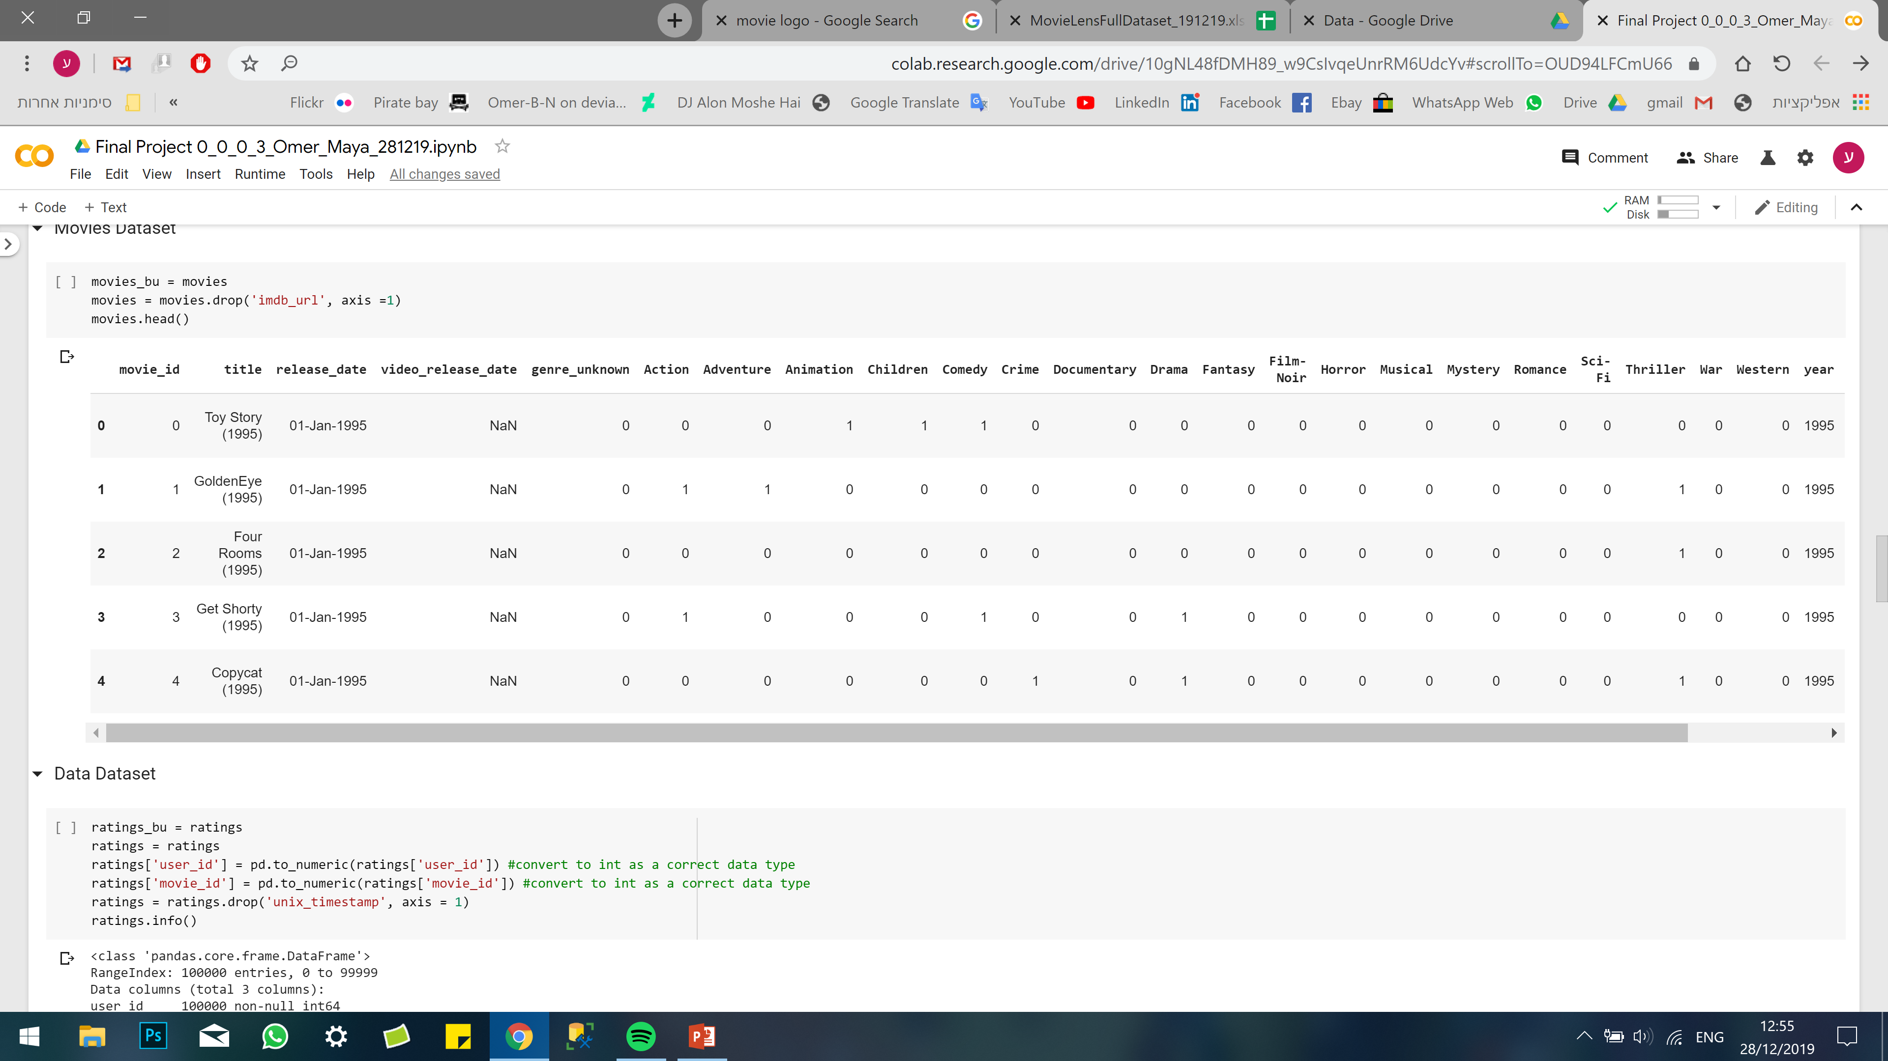
Overview – Datasets
3 datasets:
Users:
Ratings:
943
100,000
Movies:
1,682
Notes:
OMER

Slide 5


Overview – Goal
Classifying the problem:
Recommendation system
Goal:
Recommend the 10 most relevant movies to each user
Notes:
OMER

Slide 6
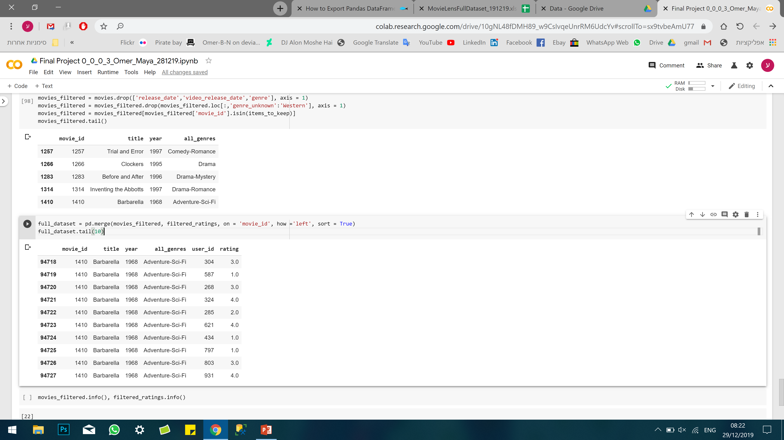
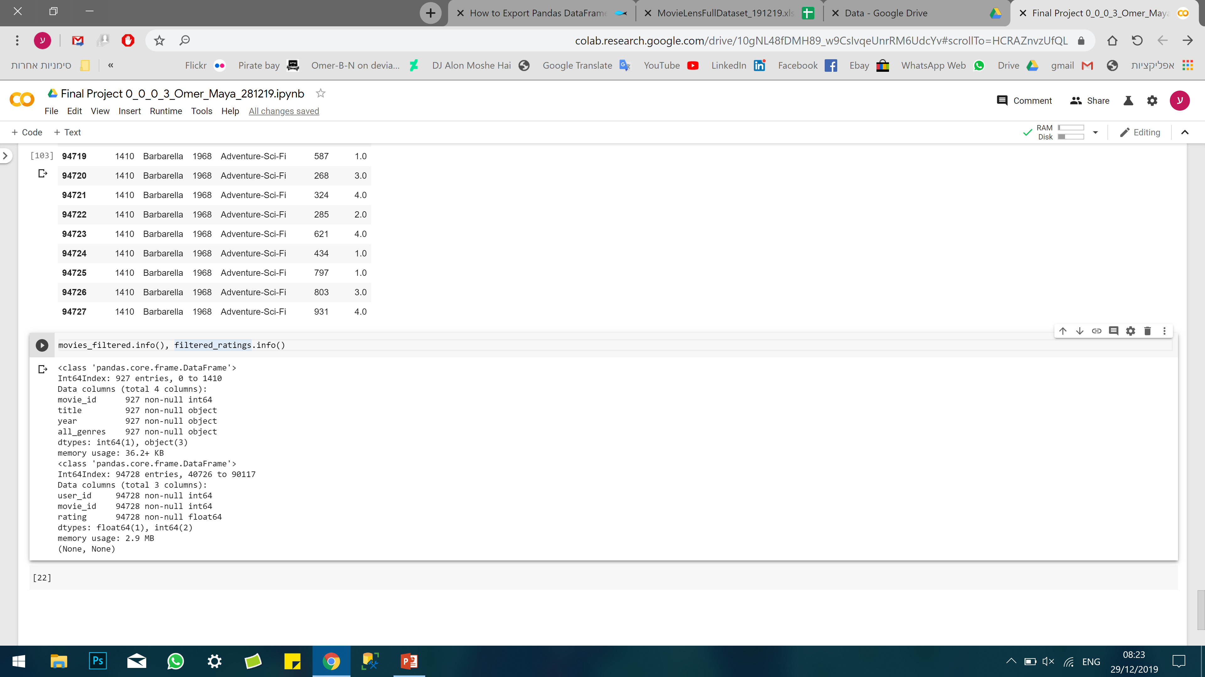
Preparation and preprocessing Filtering & Cleaning
Unite to one dataset:
‘Movies’ dataset to ‘Ratings’
Remove “one-hot encoded” like genres
Extract movie year from movie title
Replace movie id with movie title
We decided to not use the Users data, for now..
Dataset preparation:
No NA’s where found, and all the users rated at 20 movies at least.
Created metadata column of genres and
Notes:
OMER

Slide 7

Preparation and preprocessing Extracting Valuable Data (1)
Ratings
Ratings – Key to:
1. Goal Prediction
2. Identify Similar Users
Users
Movies
Notes:
MAYA

Slide 8
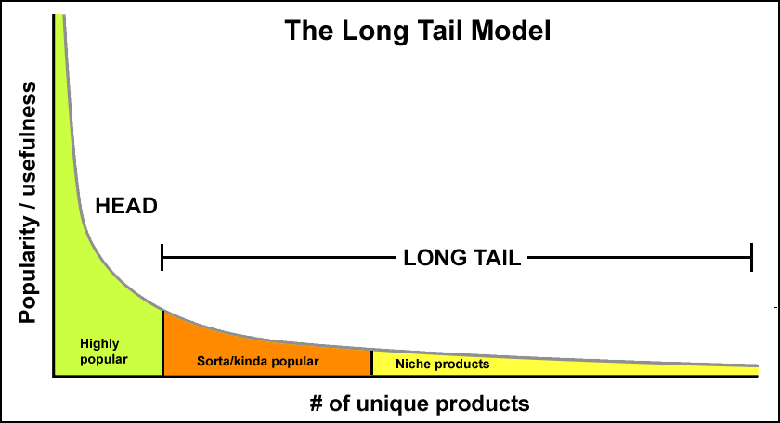
The Long Tail
Popularity / Usefulness vs. Unique Products
Notes:
OMER

Slide 9
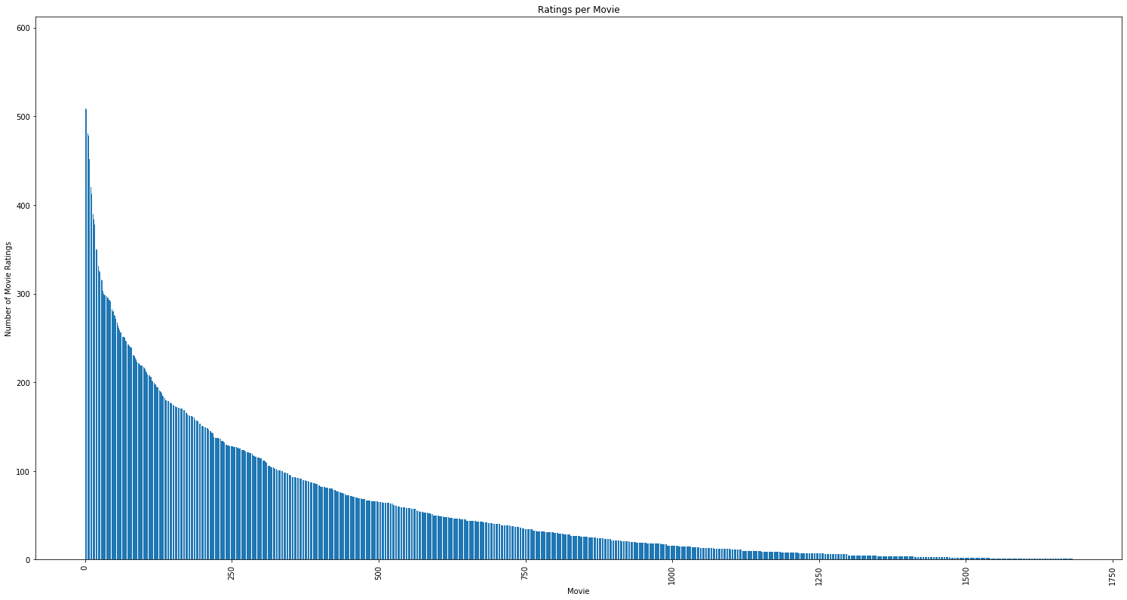
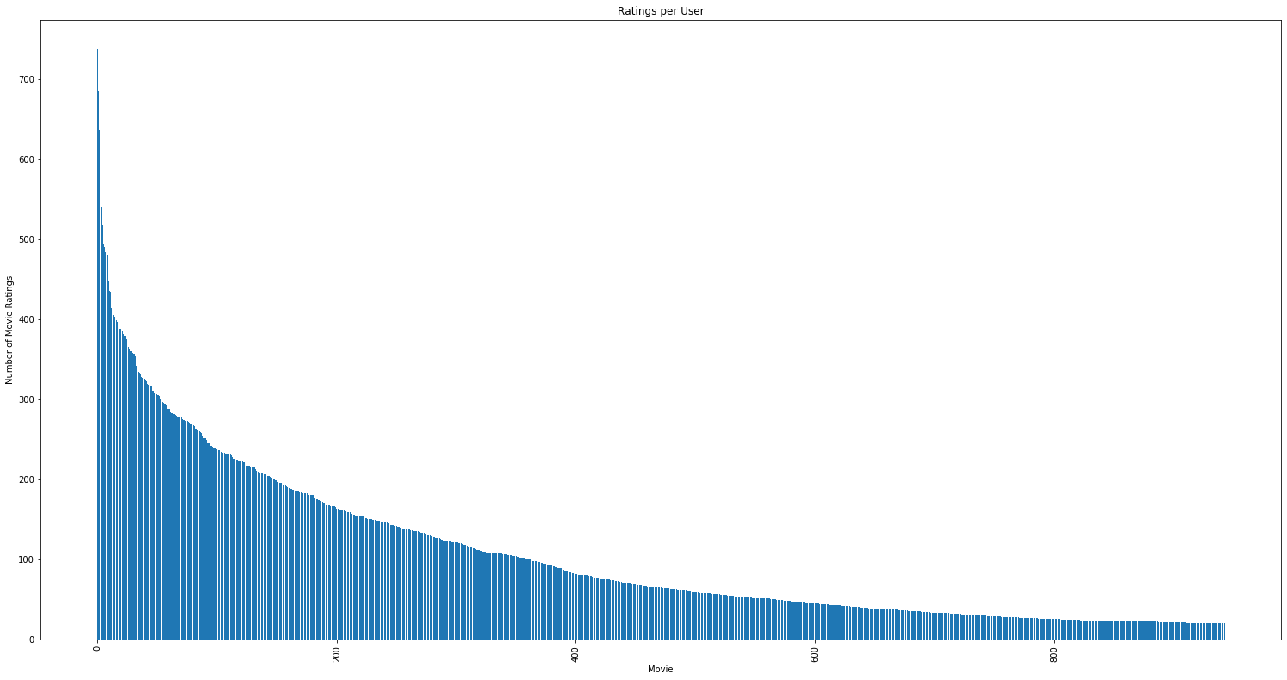


Preparation and preprocessing Extracting Valuable Data (2)
Ratings per MOVIE
Ratings per USER
Ratings
Ratings
Movies
Users
Notes:
MAYA

Slide 10

Preparation and preprocessing Extracting Valuable Data (3)
Ratings
‘Valuable’ Data Trade-Offs:
Representative Movies vs. Long-Tail Leverage
Users ‘to keep’ vs. Niche Movies
Users
Movies
Notes:
MAYA

Slide 11
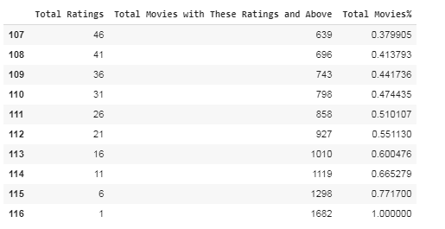
Preparation and preprocessing Extracting Valuable Data (4)
Frequency Table –
Total Ratings vs. Total Movies with This Rating and Above
Notes:
MAYA

Slide 12
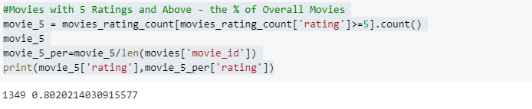
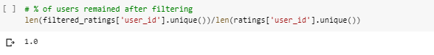
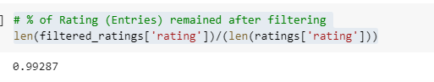
Preparation and preprocessing Extracting Valuable Data (5)
Rating >=5
1349 Movies, 80.2%
100% Users
99.3% Ratings
Notes:
MAYA

Slide 13
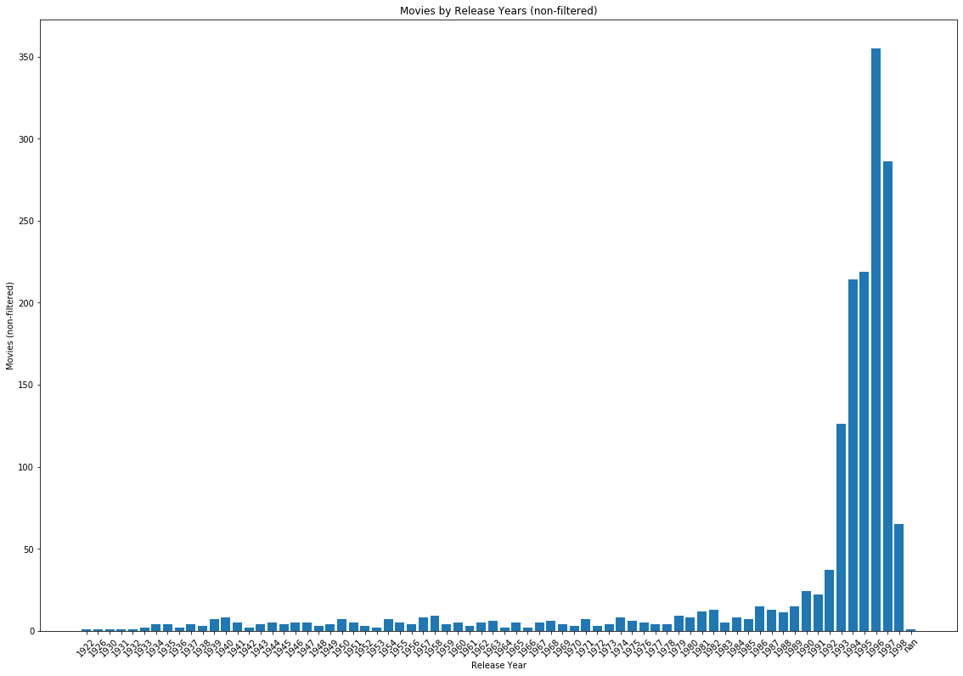
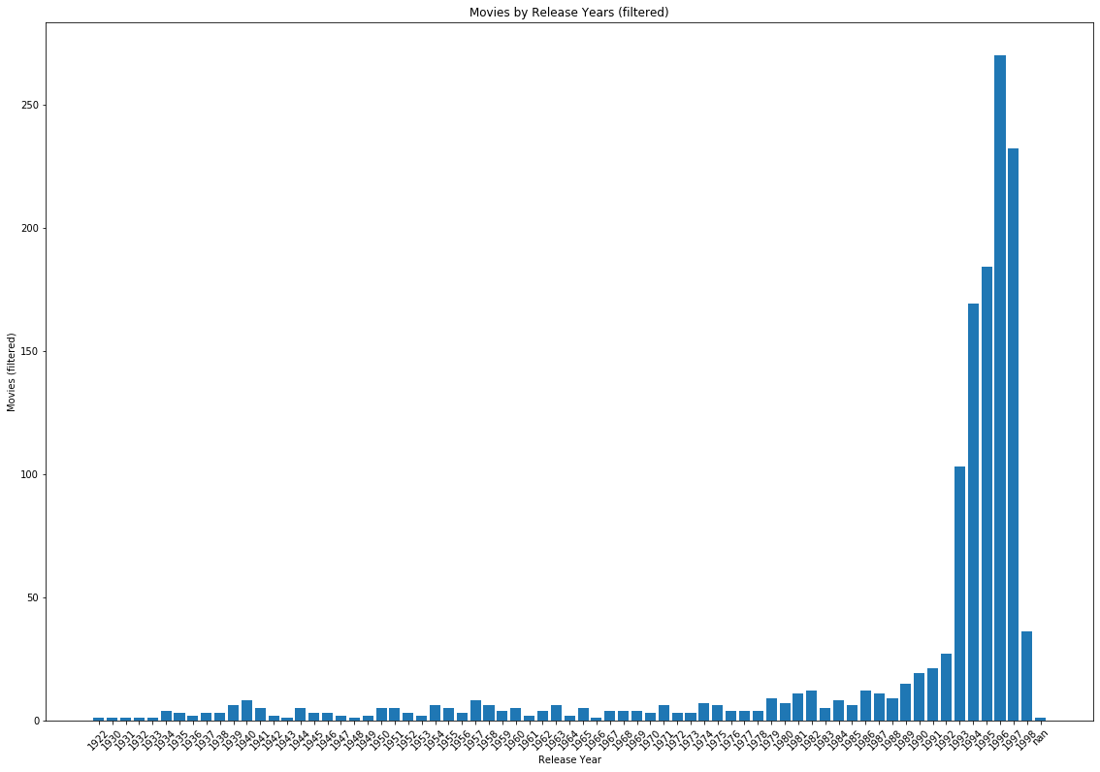
Preparation and preprocessing Extracting Valuable Data (6)
Extraction Impact (1) – Movies by Release Years:
Non-Filtered
Filtered
Movies
1993
1993
1998
1998
Release Year
Notes:
MAYA

Slide 14
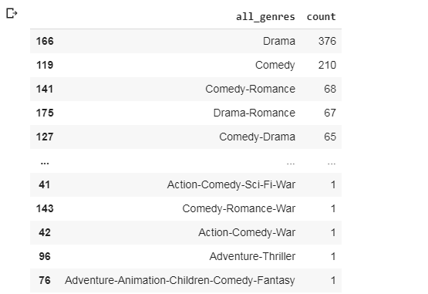
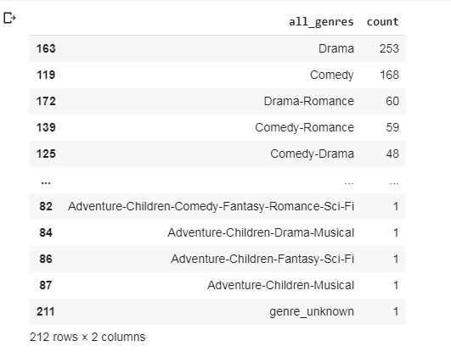
Preparation and preprocessing Extracting Valuable Data (7)
Extraction Impact (2) – Movies by Genres:
Non-Filtered
Filtered
Notes:
MAYA

Slide 15
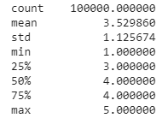
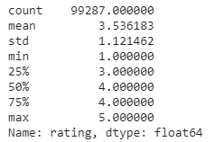
Preparation and preprocessing Extracting Valuable Data (8)
Extraction Impact (3) – Ratings:
Non-Filtered
Filtered
Notes:
MAYA

Slide 16
Preparation and preprocessing Extracting Valuable Data (9)
Ratings per Movie – ‘Valuable Data’ Baseline
Ratings
Movies with Ratings 5 and above:
80.2% of the Movies
100% of the Users
99.3% of the Ratings
5
Movies
Notes:
MAYA

Slide 17
“Plan of Attack”
Notes:
OMER

Slide 18
Recommender Systems
User content filtering vs. Item content filtering
User content filtering:
Age
Gender
Occupation
Country
Item content filtering:
Genre
Cast and crew names
Movies reviews and rating

Slide 19
Recommender Systems
Memory based vs. Model based technique
Memory based:
Create a matrix of similarities that can help predict the result.
Real-time learning
Tf-idf, similarity, clustering, Knn..
Model based:
Learn preferences based on machine learning models
Off-line learning
PCA, SVD, Neural nets., Bayesian networks..

Slide 20
Recommender Systems
Collaborative vs. Content base Recommender Method
Collaborative:
“Tell me what popular among my peers”
Based on “Hard” data – match what I liked and what my peers liked and give me items based on similar peers ratings
Content base:
“Show me more of the same what I’ve liked”
Based on “Soft” data – find what I liked based on my ratings and give me items based on the content

Slide 21
Recommender Systems
Filter
Technique
Method
DATA
User Content filtering
Item Content filtering
Memory Based
Model Based
Memory Based
Model Based
Content Based
Collaborative
Content Based
Collaborative
Content Based
Collaborative
Content Based
Collaborative
(Age, Gender, Occupation, Country)
(Genre, Cast, Keywords)

Slide 22
Next steps:
Similarity:
Cosine similarity / Pearson Correlation
Evaluation Metrics:
MAE / RMSE / Recall@K & Percision@K

Slide 23



Recommender Systems
OMER
Types of Recommendation Systems
Content-Based Filtering
Collaborative Filtering

Slide 24

Challenges
Where to start??
‘Valuable’ Identification- Long Tail Items vs. Sufficient Ratings Trade-off
Performance Measures
Notes:
OMER

Slide 25

Thank You

Slide 26
Slides for Part 2

Slide 27
Preparation and preprocessing Exploratory ‘Valuable Data’ Analysis (1)
Movies (80.2%)
Movies by Release Years
Movies by Genre
Movie
1993
1998
5
Release Year

Slide 28
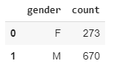
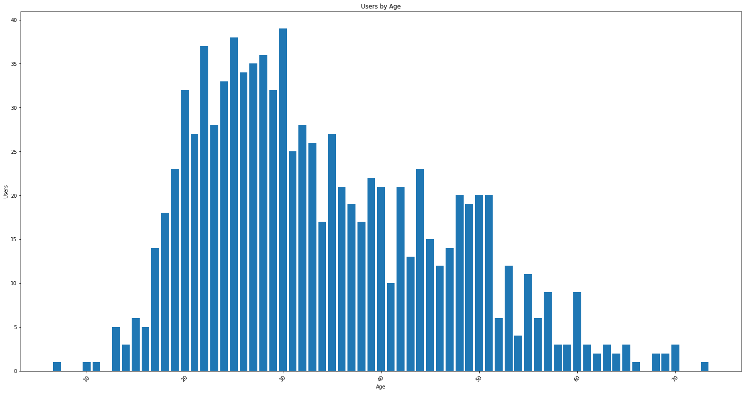
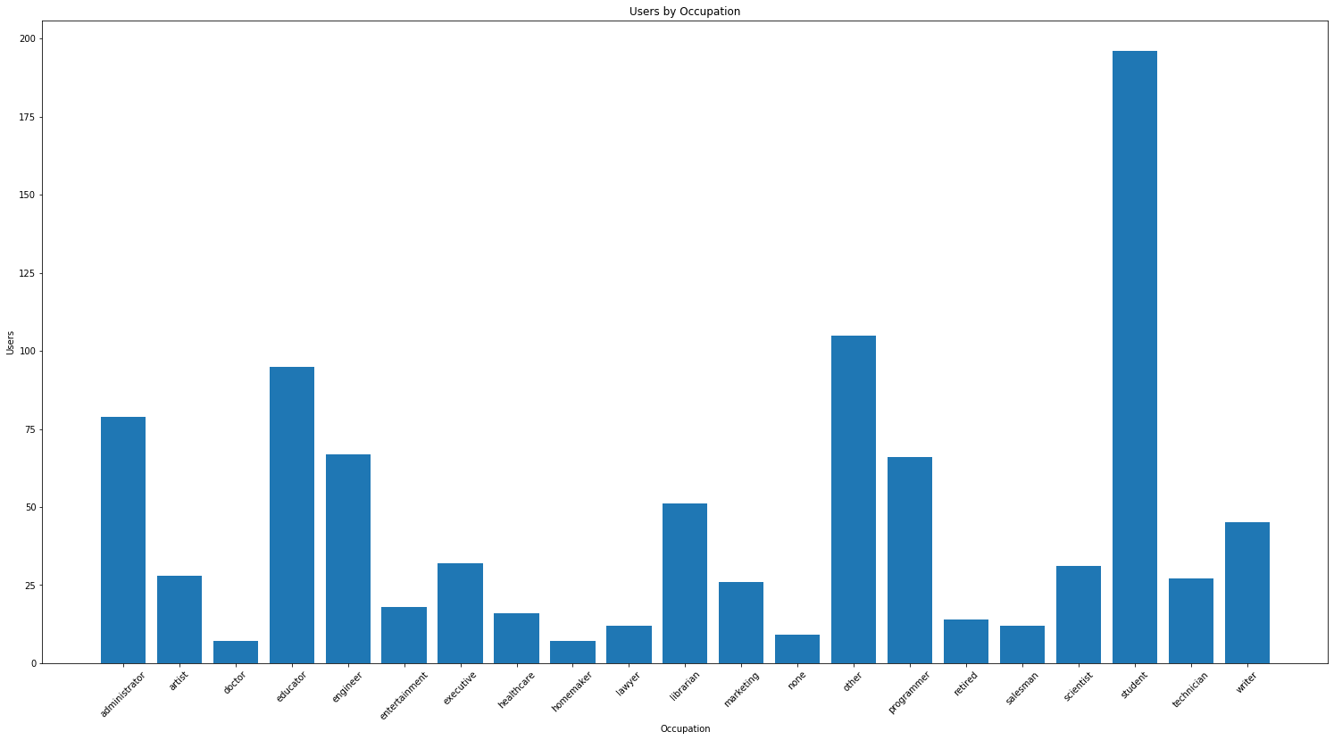
Preparation and preprocessing Exploratory ‘Valuable Data’ Analysis (2)
Users (100%)
Users by Gender
Users by Age
Users by Occupation
Student
I
35
51
17
II
60
Other
Educator
III
Administrator
Engineer
Programmer
Librarian
50

Slide 29
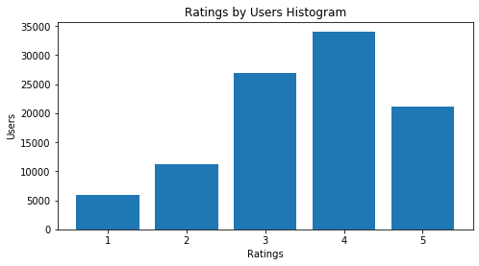
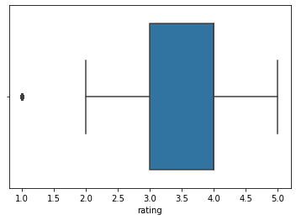
Preparation and preprocessing Exploratory ‘Valuable Data’ Analysis (3)
Ratings (99.3%)
Ratings Histogram
Ratings Boxplot
Ratings Describe

Slide 30
DRAFTS

Slide 31
Next Steps
Update slides in presentation
‘Final Touches’ to presentation
Read on & Plan Next Meeting:
ML Models
Performance Measures
Edit Jupyter Notebook
Write the Report for the 1st Part

Slide 32
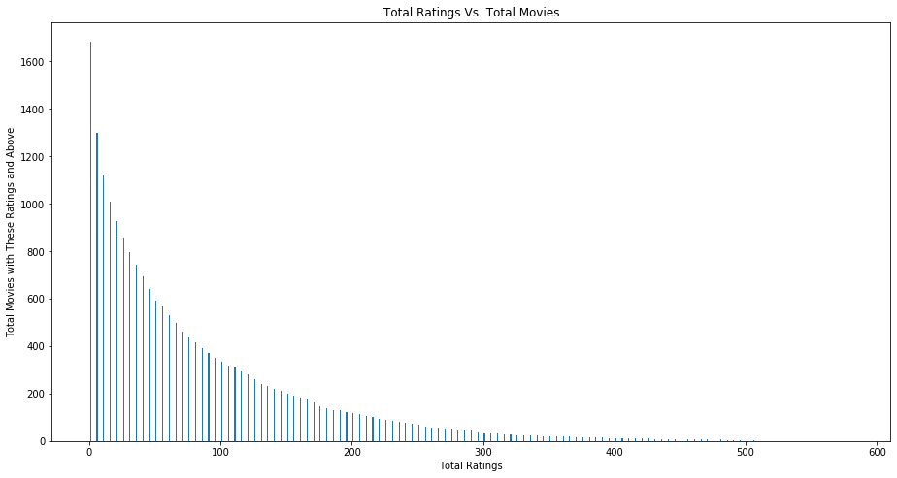
Preparation and preprocessing Extracting Valuable Data

Slide 33

Project Overview - MovieLens & Goal
Recommender Systems
Dataset
MovieLens Data
Preparation & Preprocessing
Descriptive Statistics
“Plan of Attack”
Models
Performance Measures
Challenges

Slide 34
Data Summary:
* This data set consists of the following:
- 100,000 ratings (1-5) from 943 users on 1682 movies
- Each user has rated at least 20 movies
- Simple demographic info for the users (age, gender, occupation, zip) - see 'user' tab
* This data has been cleaned up. Users who had less than 20 ratings or did not have complete demographic information were removed from this data set.
* The data was collected through the MovieLens web site (movielens.umn.edu) during the seven-month period from September 19th, 1997 through April 22nd, 1998.
GroupLens RESEARCH PROJECT
The GroupLens Research Project is a research group in the Department of Computer Science and Engineering at the University of Minnesota.
Members of the GroupLens Research Project are involved in many research projects related to the fields of information filtering,
collaborative filtering, and recommender systems.

Slide 35
Goal:
Recommend the 10 most relevant movies to users

Slide 36
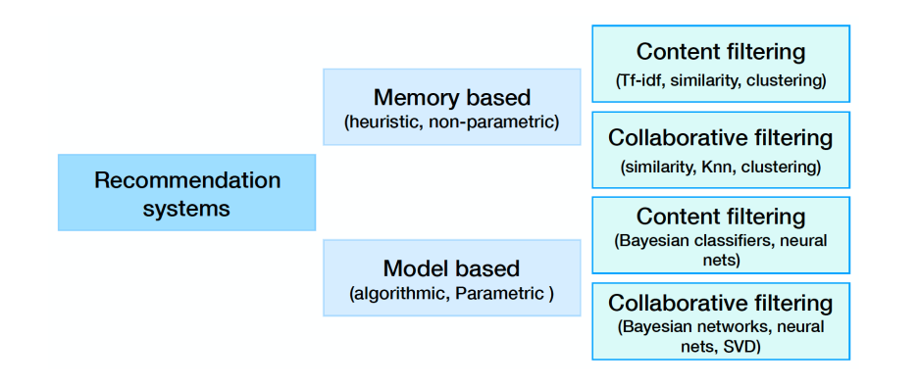
Recommendations Systems
Source: …………………………………..

Slide 37
Project Overview - MovieLens & Goal
Recommender Systems
Dataset
MovieLens Data
Preparation & Preprocessing
Descriptive Statistics
“Plan of Attack”
Models
Performance Measures
Challenges

Slide 38
Project Overview - MovieLens & Goal
Recommender Systems
Dataset
MovieLens Data
Preparation & Preprocessing
Descriptive Statistics
“Plan of Attack”
Models
Performance Measures
Challenges

Slide 39
Project Overview - MovieLens & Goal
Recommender Systems
Dataset
MovieLens Data
Preparation & Preprocessing
Descriptive Statistics
“Plan of Attack”
Models
Performance Measures
Challenges

